Slide 1
F1 Data Analysis
Team 12
Supervised by: Dr. Dina Elreedy

Slide 2
How does a track's altitude affect top speed / average lap time?
It’s believed by F1 commentators that the higher the altitude of the circuit the less oxygen there is, so the engine would not burn enough fuel.
checked the expectation by calculating the average speed of each circuit and seeing the correlation with altitude.

Slide 3
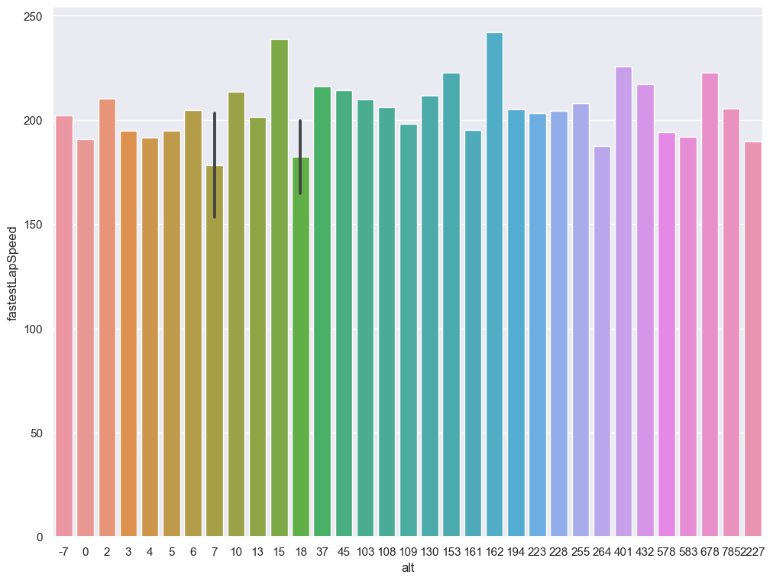

Slide 4
You can see there is no correlation, as the altitude increases, the speed doesn’t necessarily decrease

Slide 5
Which tracks have the most DNFs?
Which tracks have the most number of drivers who did not finish the race
See which tracks are brutal for the cars
Circuit 6 is the most with Did Not Finish drivers, then 14 and 9

Slide 6
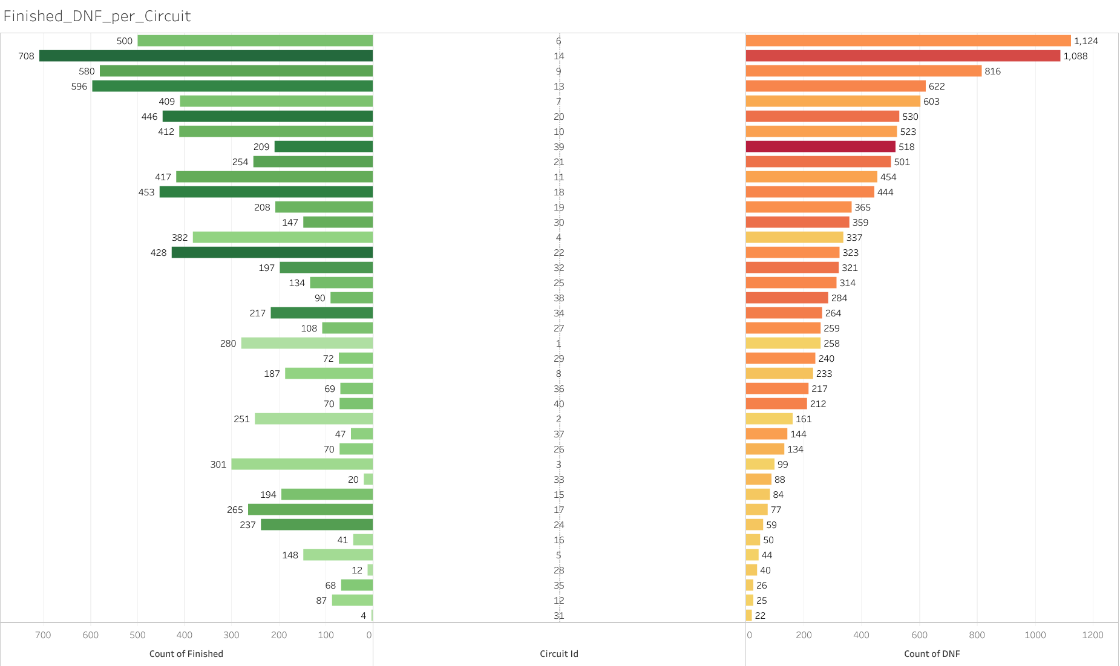

Slide 7
Which tracks favor overtaking?
Analyze which tracks are easier to overtake cars in, which will really help the drivers choose their pitstop strategies, thus they will have shorter stints but faster pace.
This is decided by seeing the start position of each driver and the end position at the end of the race, the track will favor overtaking if the positions of the drivers changed a lot from their position at the first of the race

Slide 8
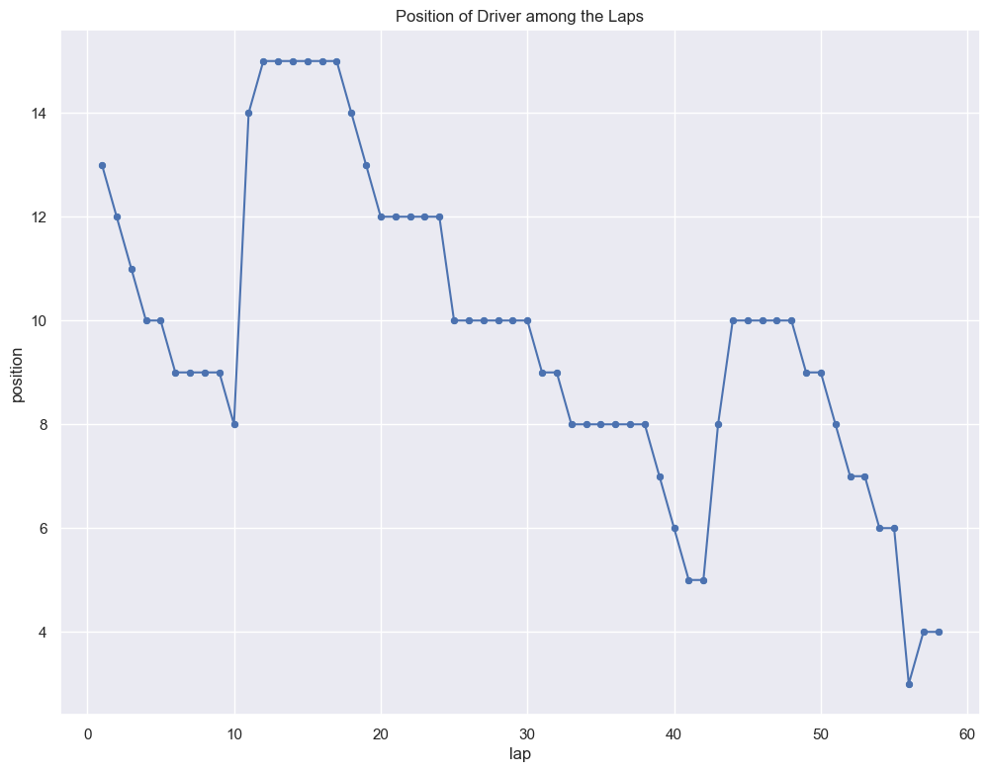

Slide 9
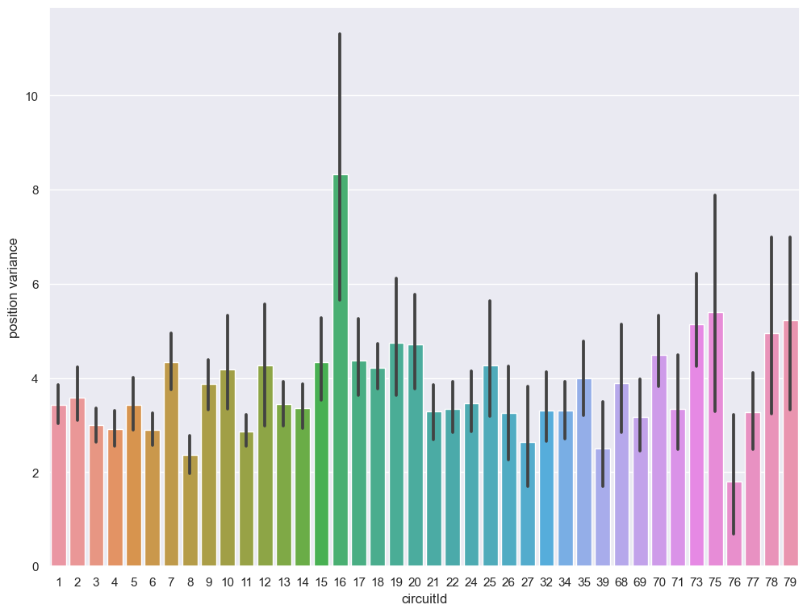

Slide 10
Does a team being the manufacturer of their engine affect performance?
Some teams like Mercedes, Ferrari, and Renault manufacture their engines.
Does this affect “performance”?
Points for drivers
Wins for teams

Slide 11
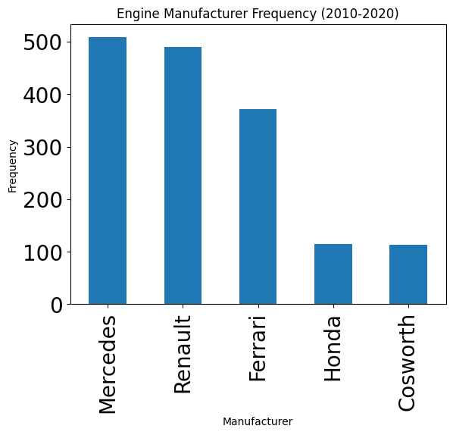

Slide 12
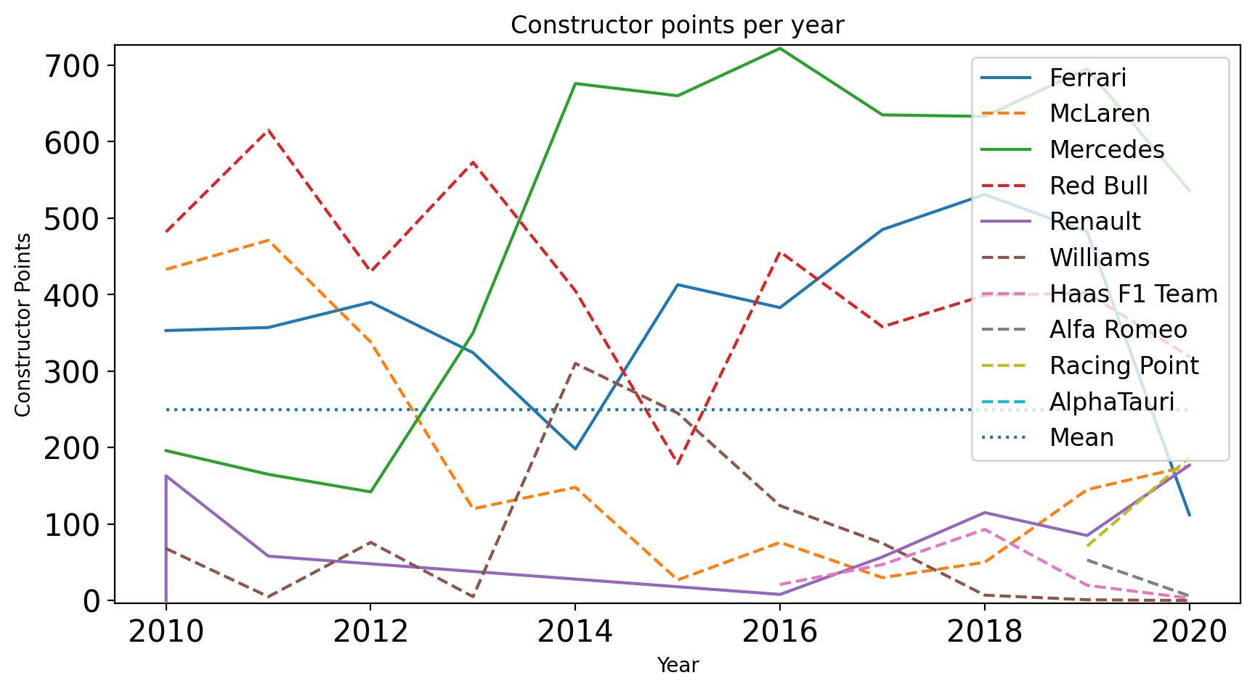

Slide 13
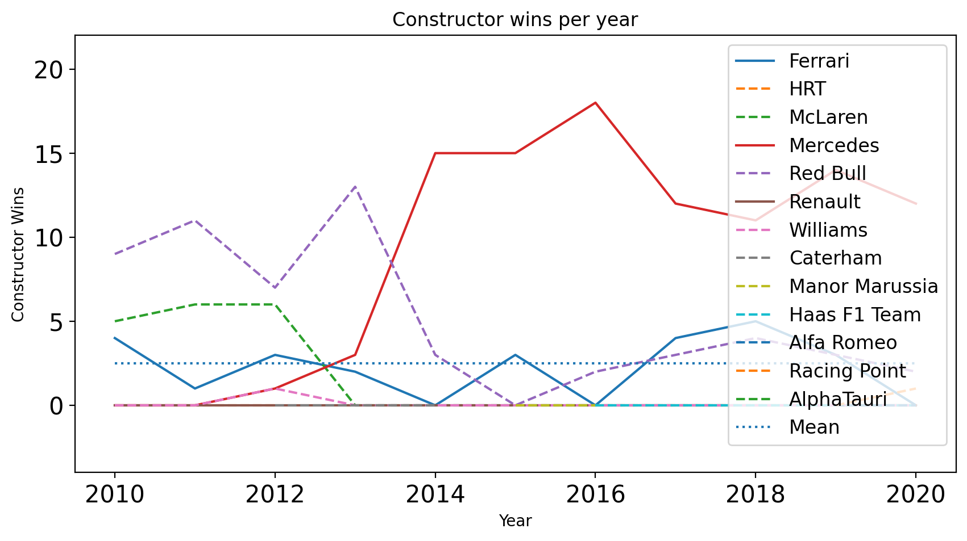

Slide 14
Conclusion
Teams that make their own engines score more points, and score more wins (to a lesser degree).
Mercedes, Ferrari, and Renault are the engine manufacturers most linked to positive scores. Mercedes and Renault are the most linked to positive wins.

Slide 15
Does having a race in your country affect performance?
Does “Home advantage” apply to F1 races as well?
Does this affect “performance”?
Points for drivers
Wins for teams

Slide 16
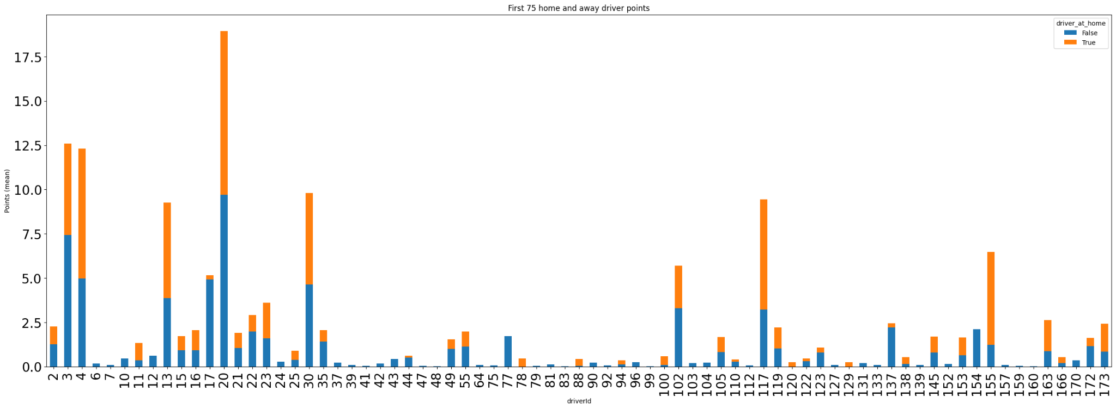
Driver Points Pre-IQR Filteration

Slide 17
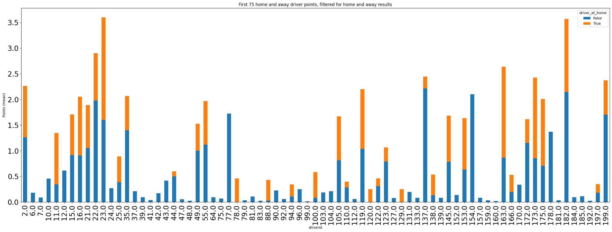
Driver Points Post-IQR Filteration

Slide 18
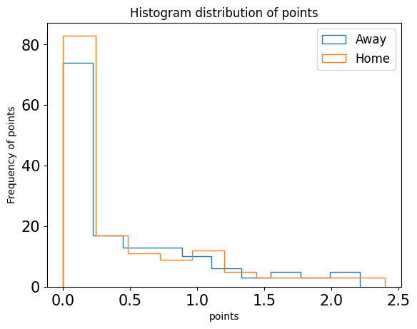

Slide 19
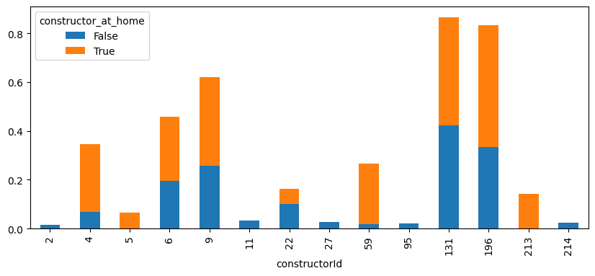

Slide 20
Conclusion
Drivers competing at home do not achieve more points on average, while constructors competing at home do achieve more wins on average.

Slide 21
Given that Mercedes drivers have above average top speed, does this apply to all German teams?
Mercedes is one of the best teams in F1.
Do other German teams follow?

Slide 22
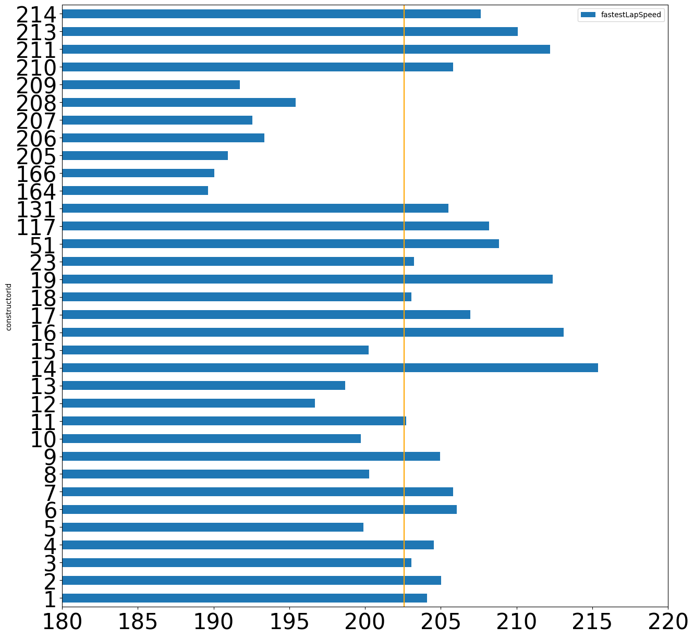

Slide 23
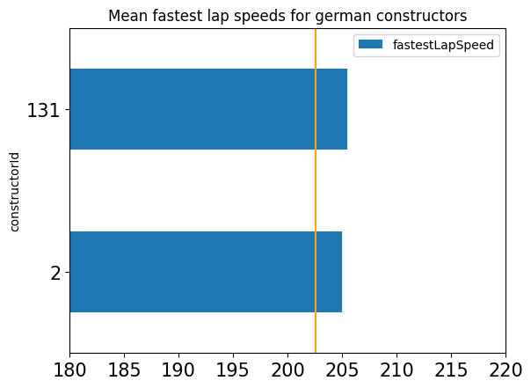

Slide 24
Conclusion
Mercedes and other German teams achieve average fastest lap speed greater than the mean fastest lap speed.

Slide 25
Optimal Pitstop
The number of pitstops in a race greatly affects the position of a driver.
Factors that affect the number of pitstops include weather conditions and tire wear, but these are difficult to quantify.
An alternative approach is to assume that the number of pitstops for the winning driver is the optimum number.
Races with more than 4 pitstops are rare and are usually due to accidents or rain, which require tire changes.
The average number of pitstops in a race can provide some information about tire wear, but it should be considered alongside other factors.

Slide 26
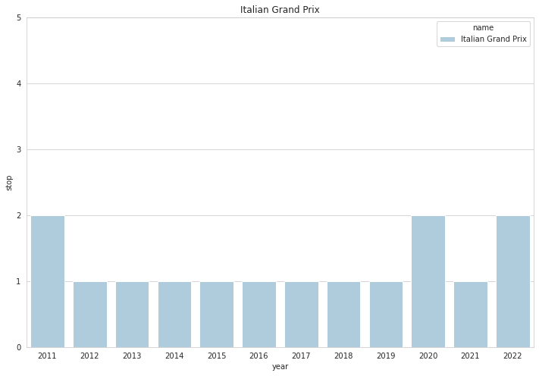
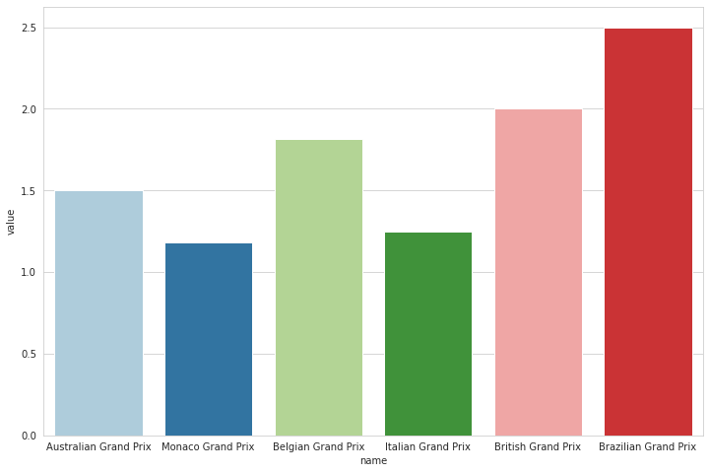
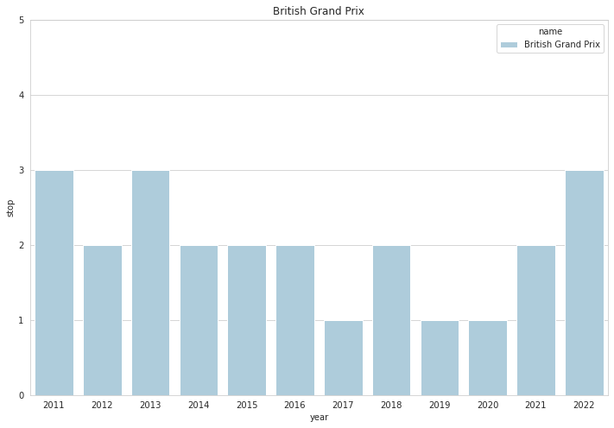
Optimal Pitstop

Slide 27
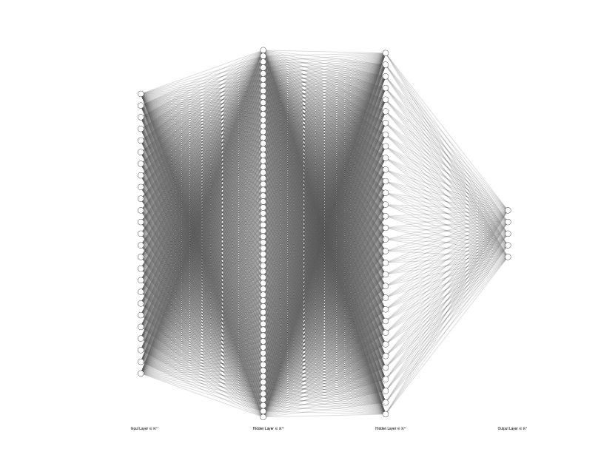
Time Series Prediction for Driver Race Results
The objective was to predict the next race results of a driver given their history.
Using 25 races sorted chronologically for each driver, with the next 5 races to be predicted, and a feedforward network was the initial approach.
Fine-tuning the model for each individual driver, using their entire history divided into 25 feature vectors, resulted in a more accurate model.
The accuracy of the model is dependent on the size of the dataset and the number of drivers being considered, so having a bigger dataset would have helped us.
Attempting to use an LSTM model was unsuccessful due to the small dataset size.

Slide 28
Position Prediction
The objective was to predict each driver's race result, and the suitable feature vector was found to include constructor_rank, driver_rank, and starting_position.
Outliers were detected in the training feature vector and had to be removed.
Various ML models were tried, and the fully connected neural networkand SVM gave accuracies of 16% and 19%, respectively.
The data was cleaned by removing rows and selecting results after the year 2000.
Despite significant iteration and tweaking, the accuracy of the model did not exceed 20%, so the project was concluded.

Slide 29
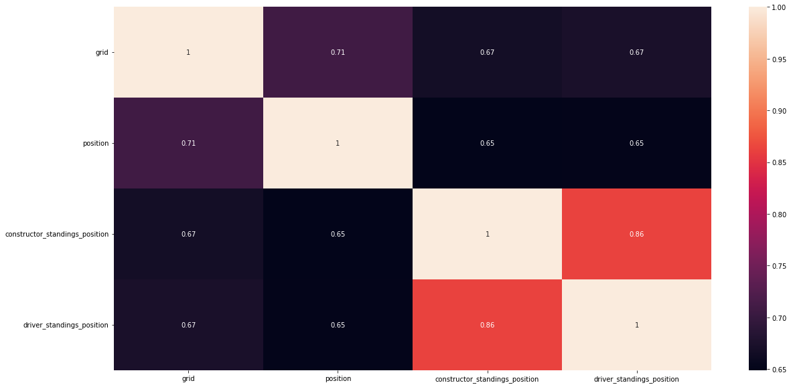
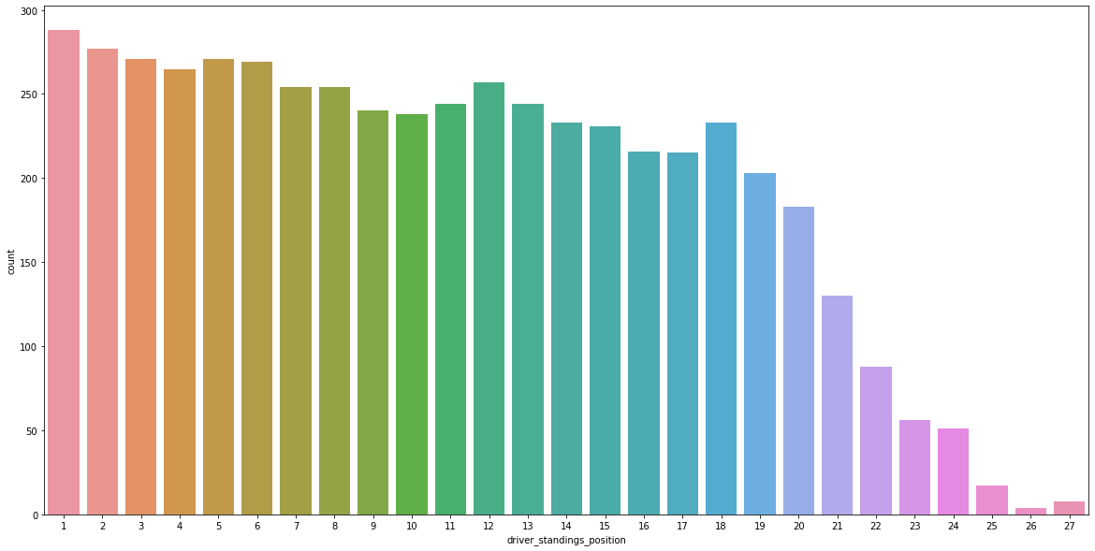
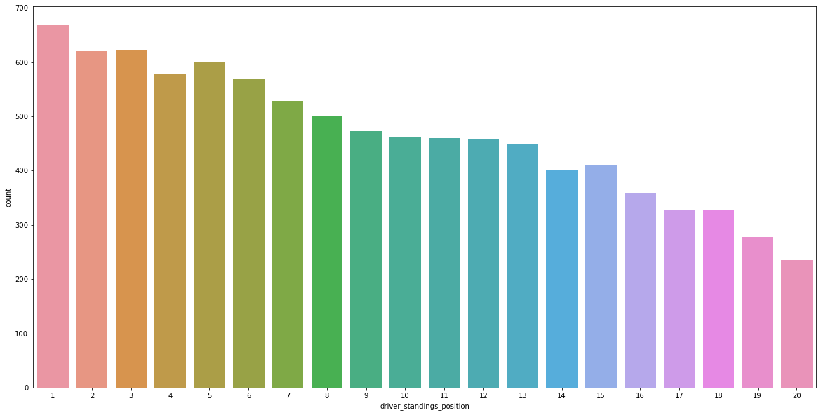
Position Prediction
Spearsman Correlation Matrix
Before Cleansing position
After Cleansing position

Slide 30
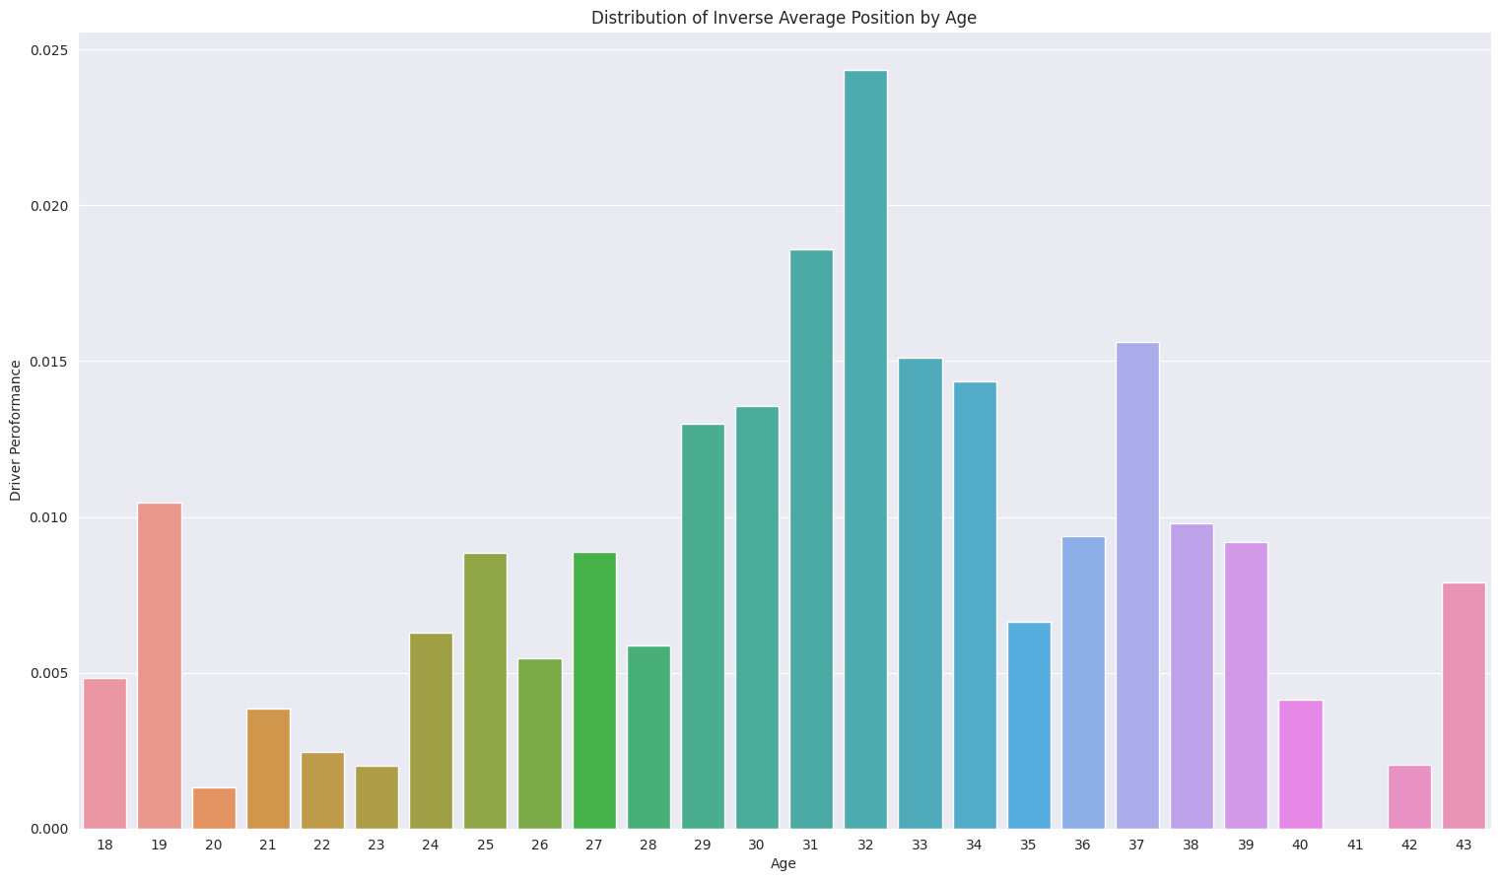
Driver’s age and position
1)Race-position pairs were grouped based on driver age.
2)Only races after the year 2000 were included in the analysis.
3)Drivers between the ages of 24 and 39 have a better chance of achieving better positions per race.
4)The best race positions were found to favor drivers in their early thirties.

Slide 31
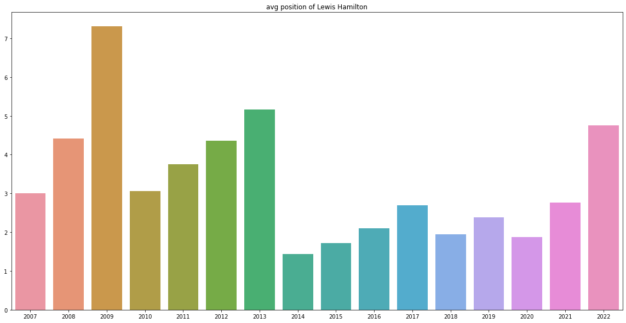
Average driver position in year
1)Average driver position over multiple seasons can indicate consistency of performance.
2)This information can be valuable for teams and sponsors when making decisions about drivers.
3)Comparing the performance of different teams and drivers over the same time period can reveal strengths and weaknesses.
4)This can help teams make strategic decisions about which drivers to enter in certain races.
5) A drastic change in the performance may also indicate that the vehicle changed not the driver

